Slide 1
Z. Gu
Embedded Systems with ARM Cortex-M Microcontrollers in Assembly Language and C
Chapter 12 & 13
Fixed-point and Floating-point Arithmetic
Exercises ANS
Fall 2025
Acknowledgement: Lecture slides based on Embedded Systems with ARM Cortex-M Microcontrollers in Assembly Language and C, University of Maine https://web.eece.maine.edu/~zhu/book/

Slide 2
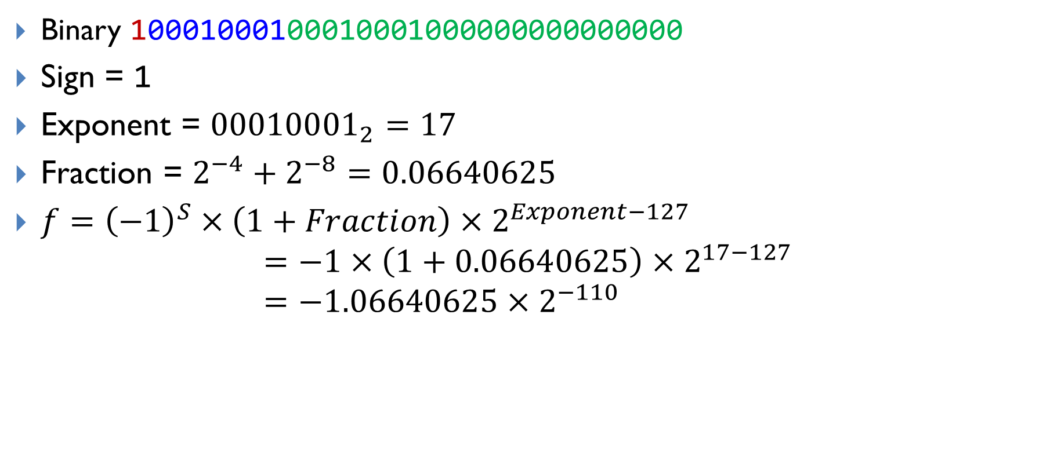
Decoding 0x88888000 into a floating-point number
Binary 10001000100010001000000000000000
Sign = 1
Exponent = ${00010001}_{2}=17$
Fraction =
$$=−1×\left(1+0.06640625\right)×2^{17−127} \\ =−1.06640625×2^{−110}$$

Slide 3
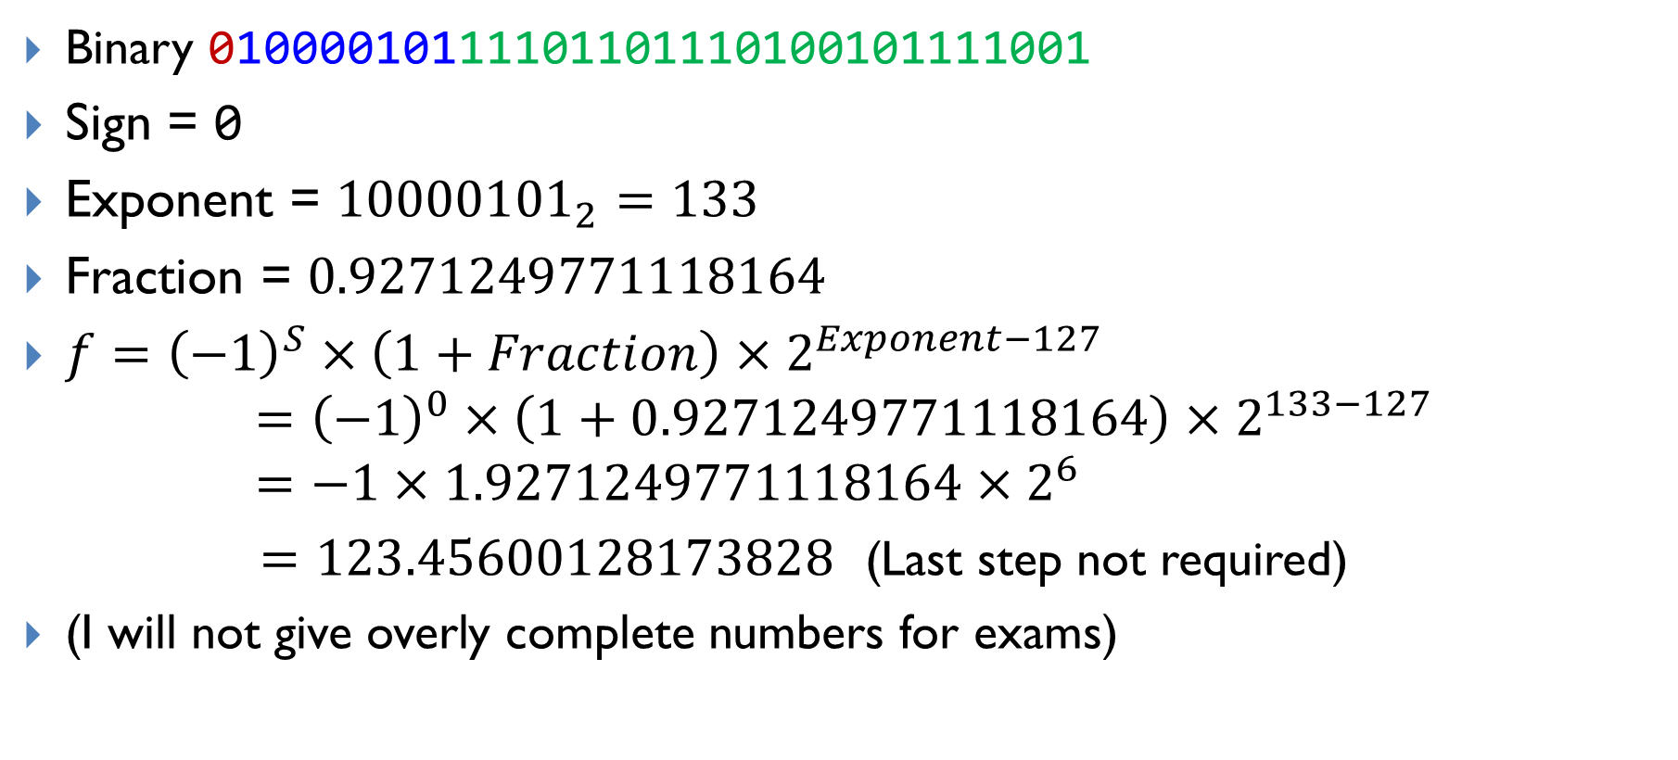
Decoding 0x42F6E979 into a floating-point number
Binary 01000010111101101110100101111001
Sign = 0
Exponent = ${10000101}_{2}=133$
Fraction = $0.9271249771118164$
$f={\left(−1\right)}^{S}×\left(1+Fraction\right)×2^{Exponent−127}$
$$={\left(−1\right)}^{0}×\left(1+0.9271249771118164\right)×2^{133−127} \\ =−1×1.9271249771118164×2^{6}$$
$=123.45600128173828$ (Last step not required)
(I will not give overly complete numbers for exams)

